Slide 1

Registry Integrity Monitoring
Security Engineering & Endpoint Detection Strategy
Sabareeshwari S

Slide 2
INTEGRITY MANAGEMENT OVERVIEW
This project engineers a Configuration Drift Detection Engine tailored for Windows endpoints. By establishing forensic-grade baselines of critical system hives, the system identifies Indicators of Attack (IoAs) through recursive integrity verification, specifically targeting unauthorized persistence mechanisms.

Slide 3


MITRE ATT&CK: PERSISTENCE MECHANICS
T1547.001 Autostart
T1562.001 Impair Defenses
Malware frequently hijacks Run and RunOnce keys to achieve execution survivability across system reboots. This monitoring engine focuses on HKLM and HKCU hives to mitigate this primary vector.
Detection of unauthorized modifications to SecurityHealthService and WinDefend keys, preventing adversaries from blinding resident EDR or Antivirus agents through configuration tampering.

Slide 4
SYSTEM ENGINEERING LIFECYCLE
Define Sensitive Hives
Establish Secure Baseline
Continuous Drift Analysis
Incident Alerting & Dispatch
Iterative monitoring loop aligned with Blue Team detection standards.

Slide 5






SECURITY ENGINEERING STACK
Python / Win32 API
JSON Artifacts
WinAPI Handlers
Utilization of winreg module for low-level system configuration access and recursive key enumeration.
Secure serialization of system state into schema-validated JSON baselines for persistent integrity checking.
Leveraging EnumKey and EnumValue for high-fidelity data retrieval across the registry manager.

Slide 6


ENGINE LOGIC & DATA STRUCTURES
Differential Logic
Detection Taxonomy
The system utilizes a Dictionary-based Delta Comparison. By mapping registry paths to unique key-value pairs, the engine achieves O(1) lookup efficiency for change detection.
The comparison logic strictly classifies drift into three operational states:
ADDED: New artifact detected (Persistence IoA)
Interval: 5.0s High-Frequency Polling
MODIFIED: Existing config tampered (Evasion)
Storage: Key-Path JSON Schema
DELETED: Security control removed (Blinding)

Slide 7
CORE DETECTION MODULES
Baseline Serialization: Captures a "Known-Good" system state into encrypted or restricted JSON structures on the local host.
Recursive Hive Traversal: Deep-scan engine that navigates through nested subkeys to ensure zero visibility gaps in configuration hives.
Alert Generation Mechanism: Immediate dispatch of event metadata to localized logging and console interfaces upon delta detection.
Forensic Logging: Archival of Path, Old_Value, New_Value, and Timestamp for post-incident RCA.

Slide 8
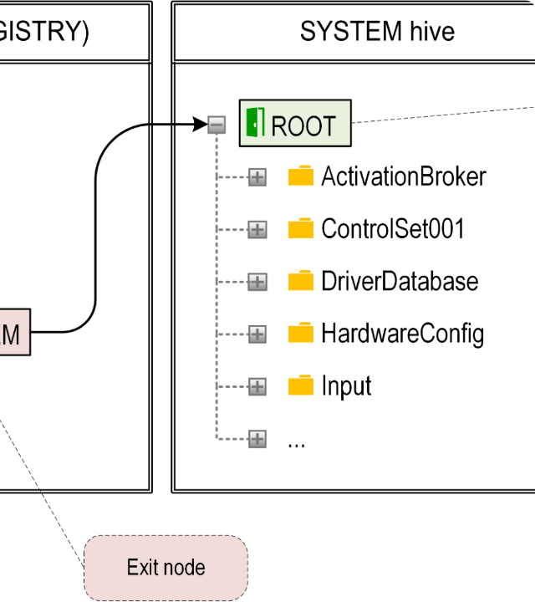
DEMONSTRATION & LATENCY
Persistence Injection Test
Scenario: Manual injection of an unsigned binary into HKCU\Software\Microsoft\Windows\Run.
Detection Latency: < 5.0 Seconds
Alert Trigger: Automated Console/Log Dispatch
The Alerting Mechanism successfully captured the delta between the baseline and the unauthorized state, providing a high-fidelity signal for incident response.

Slide 9
COVERAGE MATRIX: CRITICAL HIVES
Monitoring Hive Path | Threat Profile | Security Logic Applied
Run / RunOnce Keys | Persistence / Auto-Restart | Added-Value Detection
Winlogon / Shell | Privilege Escalation | Modification Verification
FirewallPolicy | EDR Blinding | Integrity Baseline Check
UAC Behavior | Credential Access | Policy Drift Monitoring

Slide 10
SYSTEM ROADMAP & CONSTRAINTS
Operational Gaps
Future Hardening
Current limitations include Kernel-Level Blindness (Direct memory modification) and User-Mode polling latency. Systems using Registry Symlinks may potentially evade basic polling logic.
Integration with ETW (Event Tracing for Windows) for event-driven real-time detection and automated containment through API-triggered process termination.

Slide 11
ENDPOINT SECURITY IMPACT
100%
Conclusion
The Registry Monitoring System significantly reduces Dwell Time by establishing hard-coded integrity baselines. By shifting from manual auditing to an automated Security Engineering approach, endpoints are effectively hardened against unauthorized persistence and stealthy configuration tampering.
Integrity Assurance

Slide 12
Thank You
Registry Integrity Monitoring | Blue Team Strategy
Sabareeshwari S

